Slide 1
Ant Colony Shortest Path Problem Simulation
Charles Walker

Slide 2
What is an Ant Colony Algorithm?
They are metaheuristic optimization algorithms
They mimic the swarming method of an ant colony’s process of finding shorter routes to food using pheromones.
Ants typically act as homogeneous agents but can vary depending on the version.
Both the edge length and pheromone level determine the probability of a path being chosen.

Slide 3
Ant Colony System (ACS)
Ants will decide to explore or exploit when choosing a direction.
Exploit means the strongest path is chosen.
Explore mean probability-based choice.
Locally updates pheromones as ants traverse an edge.
Reduces that paths pheromones to encourage the use of other paths.
Globally updates the pheromones of all edges.
All pheromone levels decay
Only the best path increases in pheromone levels
Notes:
The version I chose

Slide 4
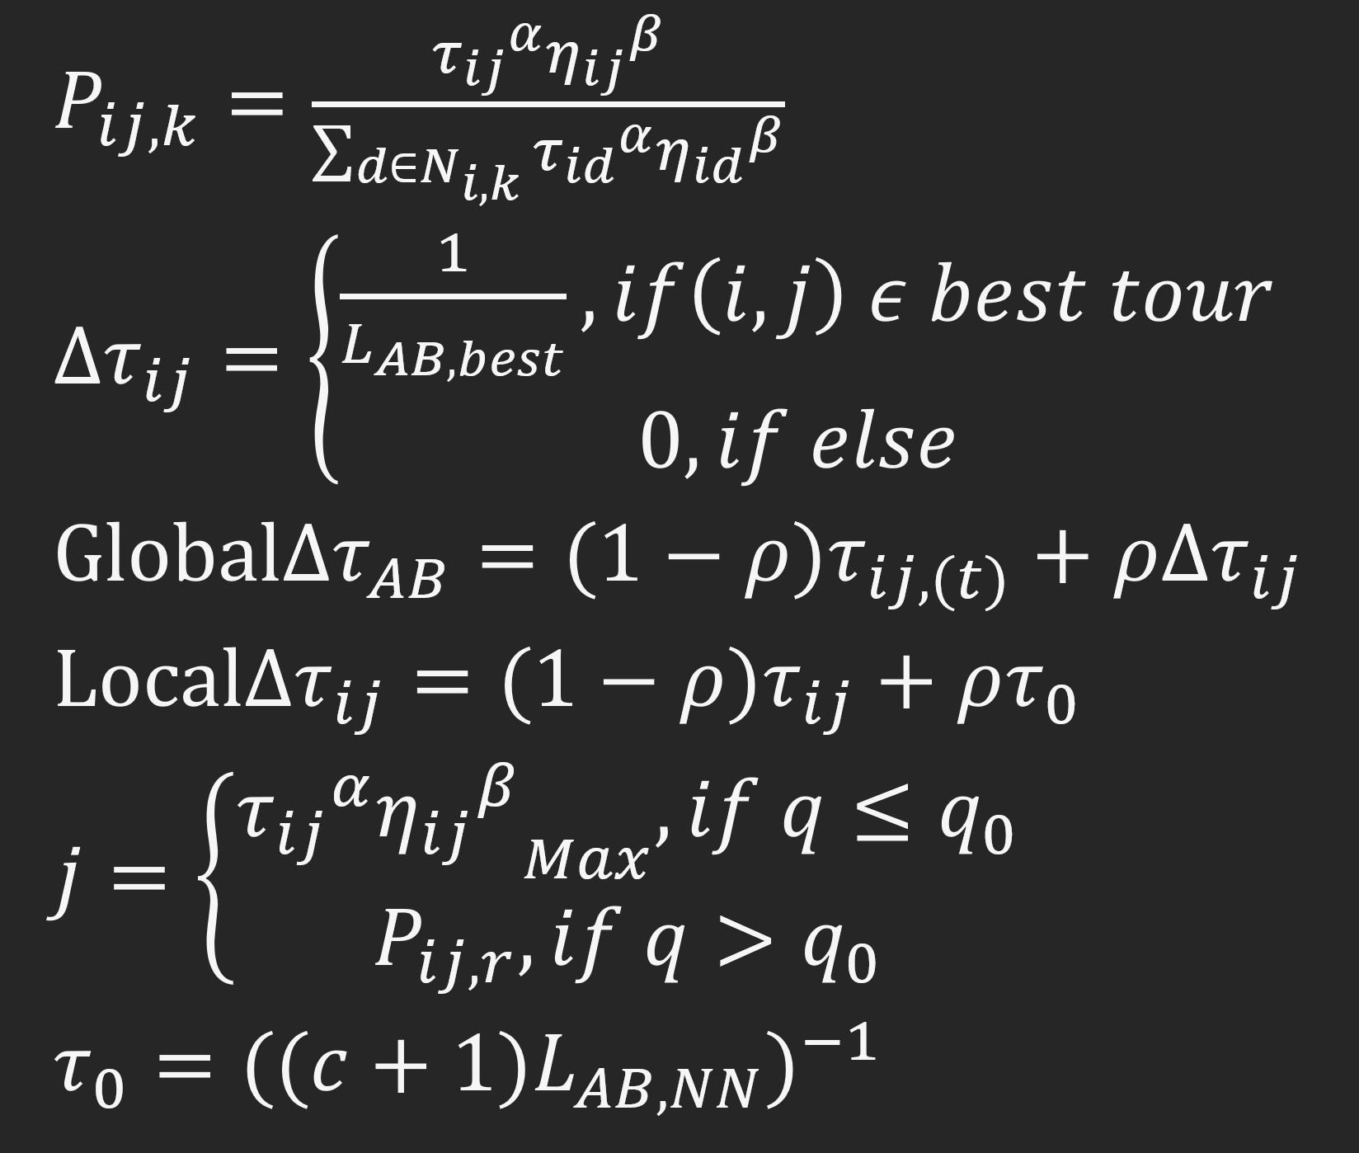
Independent Variables
k = Number of ants
α = Pheromone importance
β = Heuristics importance
ρ = Pheromone decay rate
q₀ = Chance of choosing to exploit the strongest edge

Slide 5
Research Questions
Can the ACS algorithm dependent variables be adjusted to find a solution for a SPP within a known range of best solutions in an estimated average number of computations?
Do optimal independent values vary based on the problem's size?
Do optimal independent values vary based on the differences in edge costs?
What independent variables hold more weight in finding a solution, and at what problem sizes?
Notes:
Given the limited time for this project, no definite conclusion was expected. The goal was to determine what was suggested from the data I could collect.

Slide 6
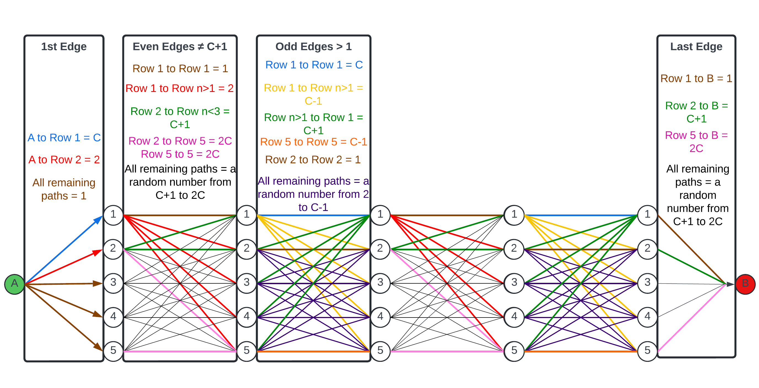
The Graph Model
Notes:
Designed for testing the ant colony system algorithm.
Allows for changing graph size with and without increasing the differences in edge costs.
The simulation only runs column sizes of odd integers greater than 5

Slide 7
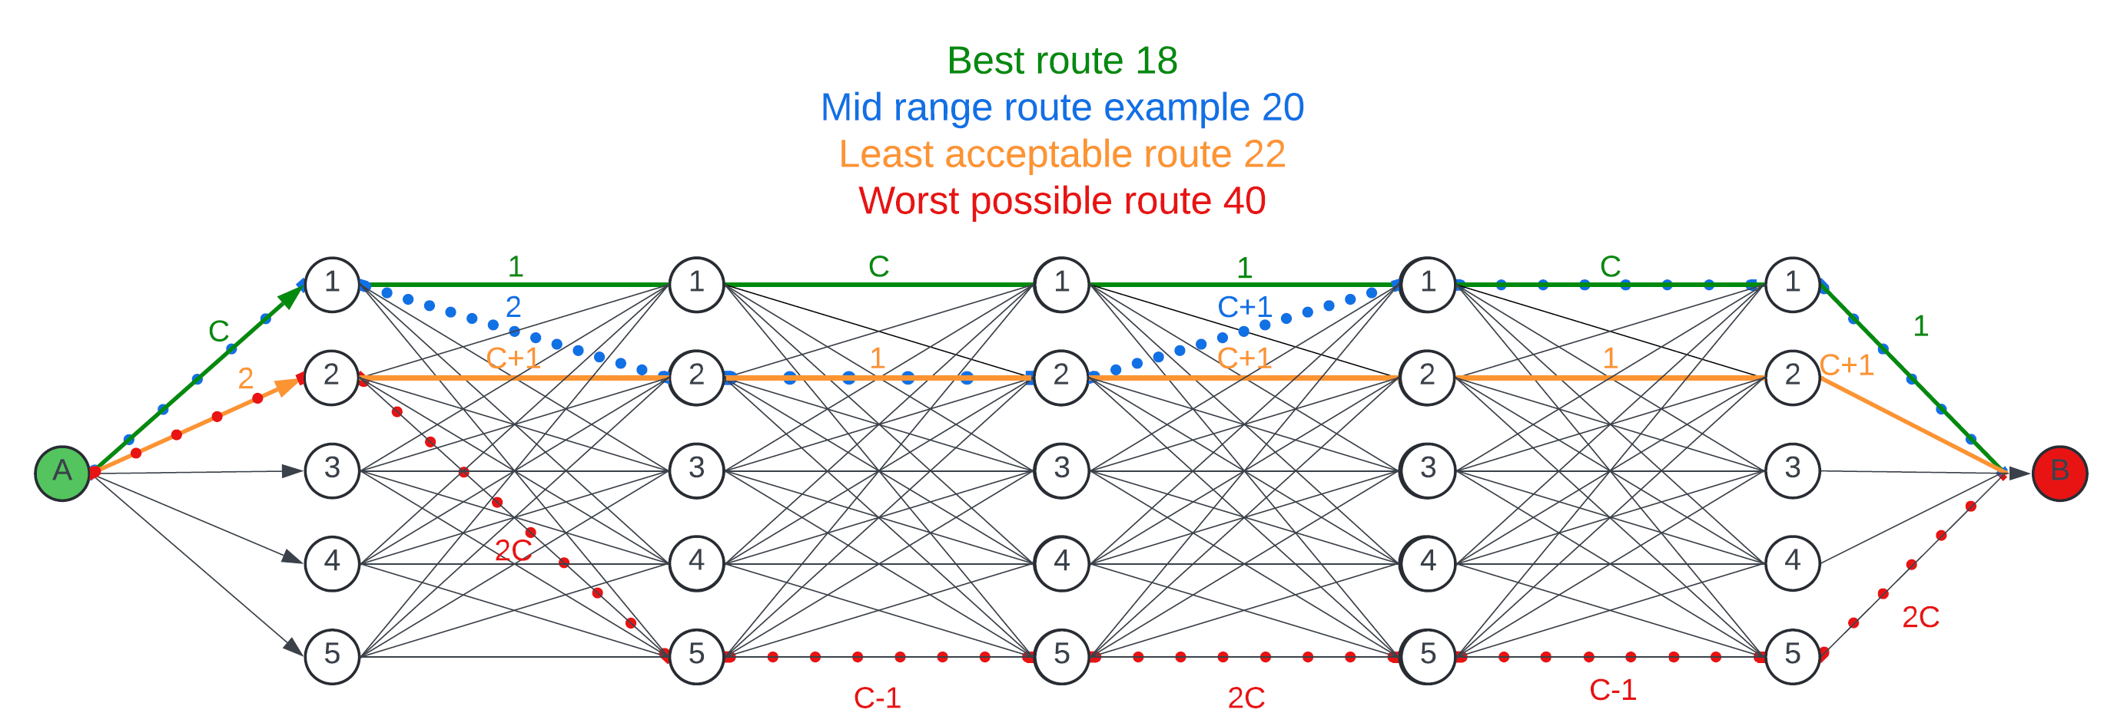
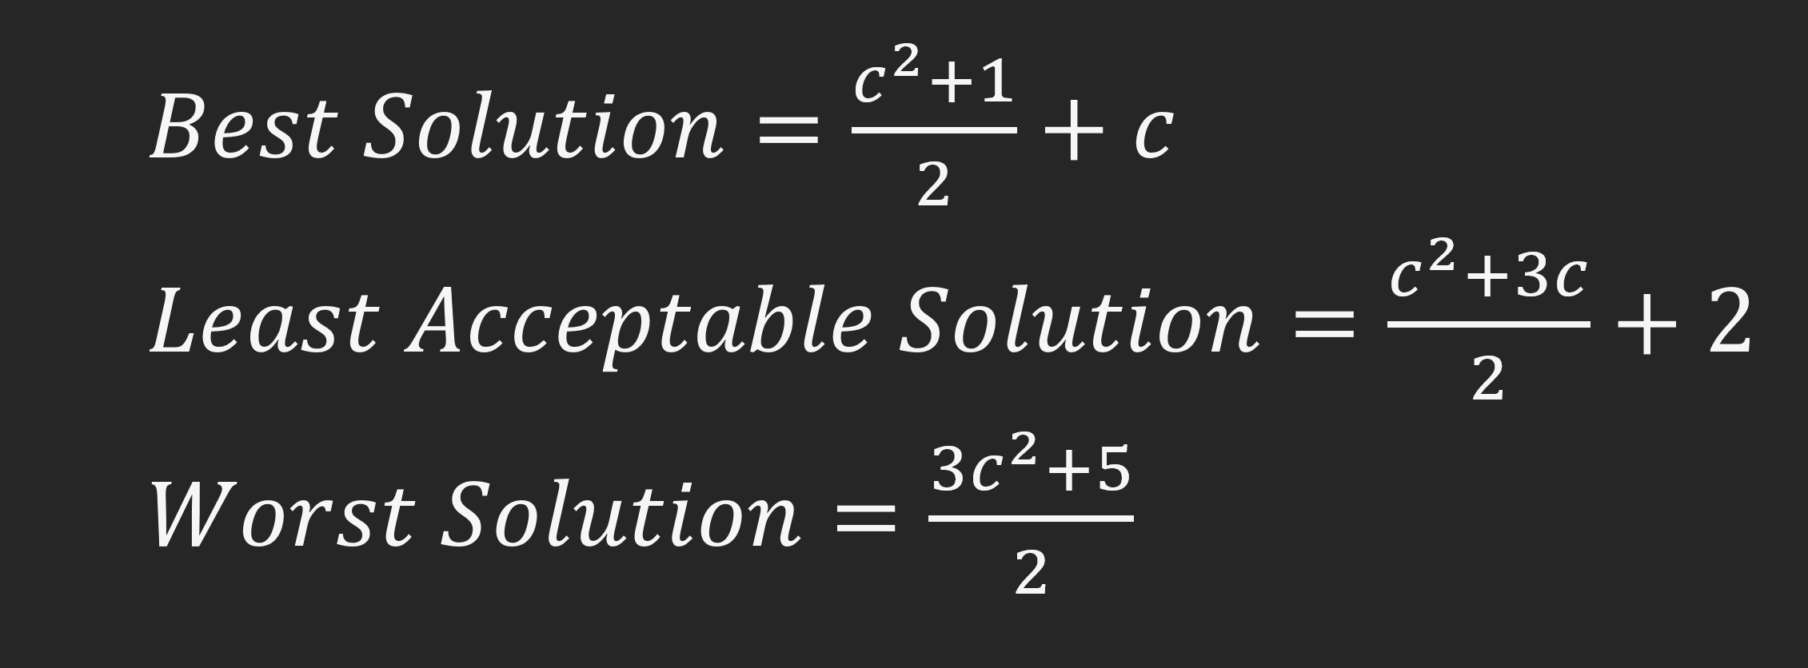
Known Paths

Slide 8
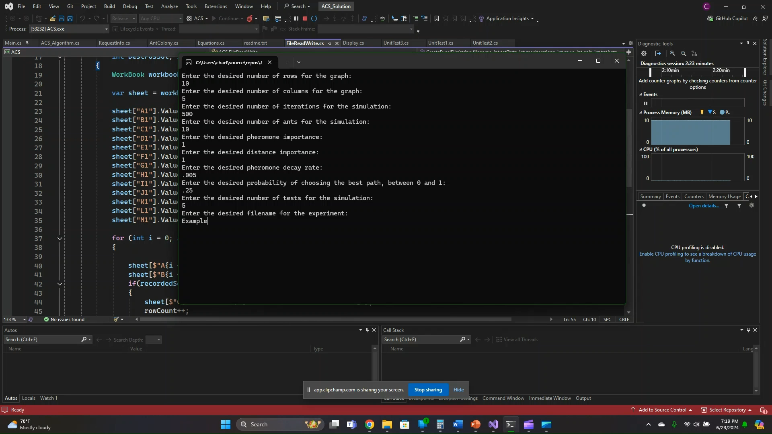

Slide 9
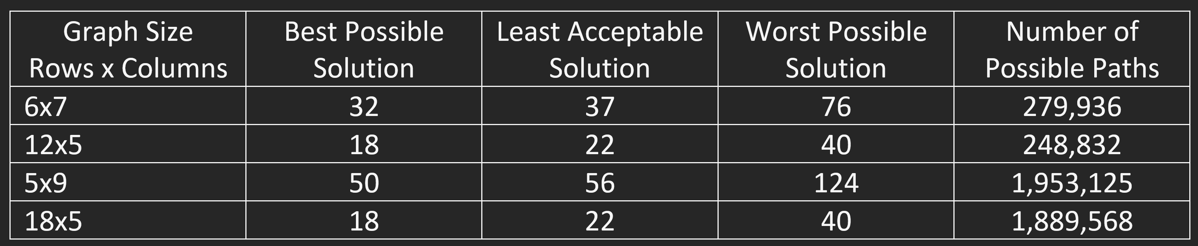
4 Experiments: 1 for Each Graph Size
Notes:
These graph sizes were chosen because they each have a pair that has different ranges in edge costs and similar number of possible paths.

Slide 10
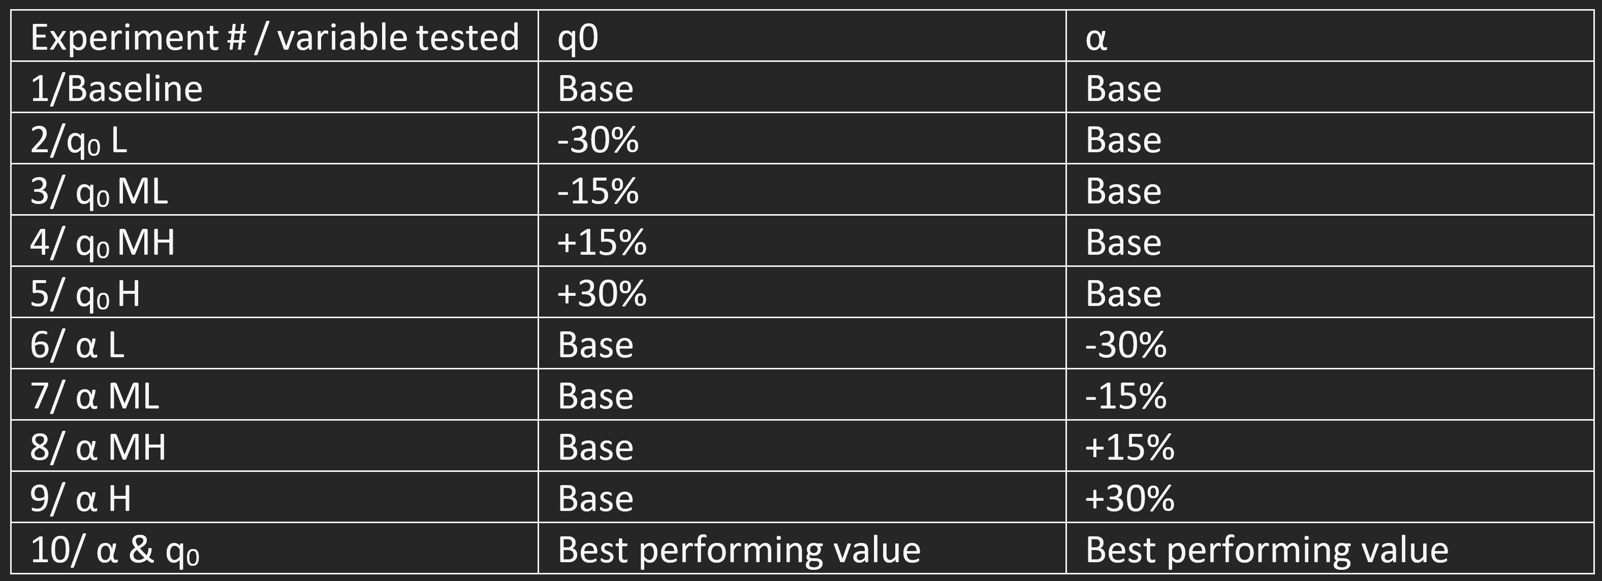
Experiments Consisted of 10 Tests Each
Notes:
Each test rans 75 times
Each test ran until either the best solution is found or 2000 iterations are reached

Slide 11
Data Analysis
Effectiveness:
The number of times an acceptable was found in each test.
The number of times the best solution was found in each test.
Efficiency:
The number of iterations needed to find an acceptable solution.
The number of iterations needed to find the best solution.

Slide 12
Summarized Results
Experiment Graph Size | T_{BSC} | μ_{BSI} | σ_{BSI} | T_{LASC} | μ_{LASI} | σ_{LASI}
6x7 Baseline | 11 | 676.909 | 95.177 | 75 | 74.32 | 59.6
6x7 q₀L & αL | +172.7% | +59.7% | +467.3% | 0.000% | +0.2% | +13.7%
12x5 Baseline | 10 | 743.6 | 380.374 | 75 | 35.64 | 37.381
12x5 q₀L & αL | +90% | +27% | +18.6% | 0% | -11% | -18.8%
5x9 Baseline | 2 | 787 | 152.735 | 75 | 131.147 | 128.989
5x9 q₀L & αL | +1000% | +24.3% | +196.449% | 0% | -22.9% | -26.2%
18x5 Baseline | 1 | 530 | 0 | 75 | 60.467 | 56.173
18x5 q₀L & αL | +800% | +81.9% | N/A | 0% | +11.9% | +22.8%

Slide 13
Research Questions 1 & 4
Acceptable solution data was invalidated due to an oversight in the graph model design and experiment design.
Each test used a different graph with an unknown percentage of acceptable solutions.
A lack of possible solutions
Example: 5x9 graph has 71 possible solution values out of 1,953,122 paths.
Notes:
It's impossible to know how many acceptable solutions existed in any graph tested. One test could have had 15% of its possible solutions in the acceptable range, while another test in the same experiment could have had 30% of its possible solutions acceptable. This makes it possible for a value that did actually perform better to appear worse or vice versa.
After further analyses, I noticed a lack of possible solutions values over any given sets of paths which would dilute the accuracy of the results.

Slide 14
Some Data is Valid
The number of best solutions found remains a valid test result because each graph only had one best solution.

Slide 15
Research Questions 2 & 3
In regards to the number of times the best solution was found and iterations required:
When the better-performing values were tested together:
On the 6x7, 5x9, and 18x5 graphs, the algorithm performed more efficiently and effectively than the other 9 tests
On the 12x5 graph, the -30% of baseline q₀ value performed the best but only slightly better than both variables at their lower values.

Slide 16
Research Questions 2 & 3 Cont.
These findings suggest:
The α variable may have varying optimal values when applied to graphs with larger edge costs and sizes, compared to graphs with smaller differences in edge costs and smaller sizes.
The q₀ variable may have a consistent optimal value regardless of the differences in edge cost or problem size applied.
More testing is needed to explore emergent behavior between varying variable values and graph types.

Slide 17
Future Work
Alter the graph design to account for the amount of acceptable solutions.
Change the simulation process to use the same graph for each test in an experiment or create set values for all edges.
Further experiments on the relationship between varying values of independent variables.

Slide 18

Questions?

